Slide 1
Music Classification
Sebastian Cortes
Jon Gorel
Eamon Kostopulos
James Kaufman
Ahmed Mohamed

Slide 2
Introduction
People listen to their personal song files everyday, but some of those songs can be incorrectly sorted by genre.
You may find rock songs in pop-based playlists.
With a creation of a functional and precise neural network, songs can be correctly tagged with their specific genre.
We desired to create such a neural network.

Slide 3
Our Idea
Develop a convolutional neural network that decides which genre an input song is from.
We generate, or find, a dataset of unlicensed songs that have already been indexed into a specific genre set.

Slide 4
Generating a dataset
We first decided to create our own dataset of 5 genres that we knew of.
Attempt 1 genres:
Classical
Electronic
Post-Hardcore
Folk
Rap
Then we ran into the issue of licensing music.

Slide 5
Why unlicensed music?
To create our convolutional neural network, we need a very large dataset.
Licensed songs would require for the artist or company that owns the distribution rights to give us permission to use it and distribute to other if they wanted to use our dataset.
Otherwise, we would have had to cite every single songs we used to train the neural network.
At first, we started with around 70+ songs, but we wanted to expand our number of songs well into the hundreds. That would have required the same number of citations

Slide 6
Million Song Dataset (MSD)
We tried using a subset of MSD that consisted of 10,000 songs (1.8 gb).
However, we were unable to extract the information required to fully build the required dataset.
Instead of MP3 files that we wanted to use, it had only metadata.

Slide 7
Free Music Archive (FMA)
So we discovered the Free Music Archive.
FMA had multiple forms of the dataset, ranging from 8,000 tracks of 30 seconds to 106,574 tracks of 30 seconds.
The chosen dataset had 8,000 tracks of 30 second length and 8 balanced genres.
Balanced genres allowed us to know for sure that all genres had the same amount of data as the other genres.

Slide 8
Sorting Process
Rather than the 30 second snippets the dataset was in, we decided to cut it down to 5 seconds.
Each dataset came with a .csv file that had every single song in a table that had assigned it an ID and a genre label.
This made it easy for us to create a python program to sort through all the music files and move them to their respectively-named genre folder.

Slide 9
New Data Set
Attempt 2 Genres:
Rock
International
Hip-Hop
Pop
Experimental
Folk
Electronic
Instrumental

Slide 10
Training Process
Sort the songs into their corresponding genre folders
Cut the songs into 5-second snippets
Convert the snippets to MFCC (Mel-frequency cepstral coefficients)
Train the network using the MFCC data

Slide 11
Convolutional Neural Network
When it came to analyzing Mel-Spectrograms and MFCCs a convolutional neural network is the best fit.
This is because Mel-Spectrograms and MFCCs are easily visualized as a kind of graph representing audio
Convolutional Neural Networks are used primarily in analyzing visual data

Slide 12
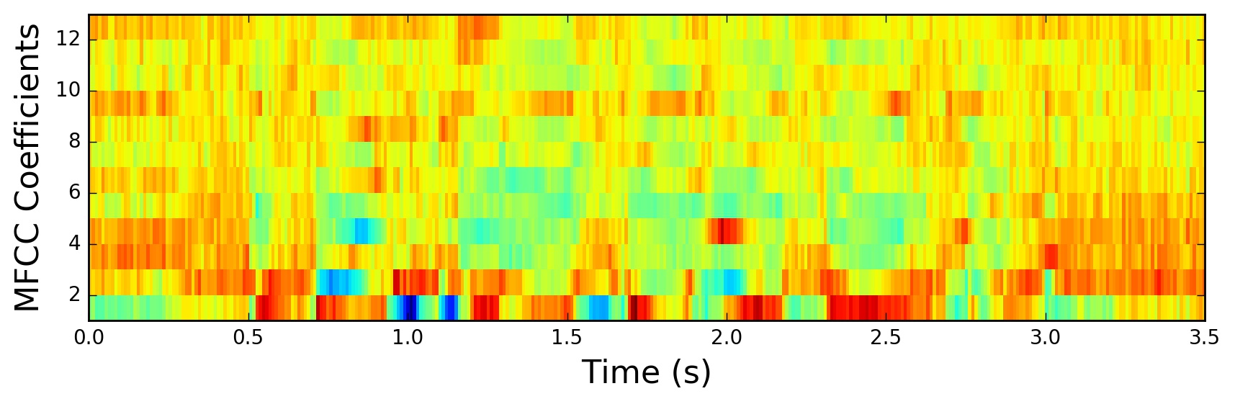
MFCC
Source: haythamfayek.com [1]

Slide 13
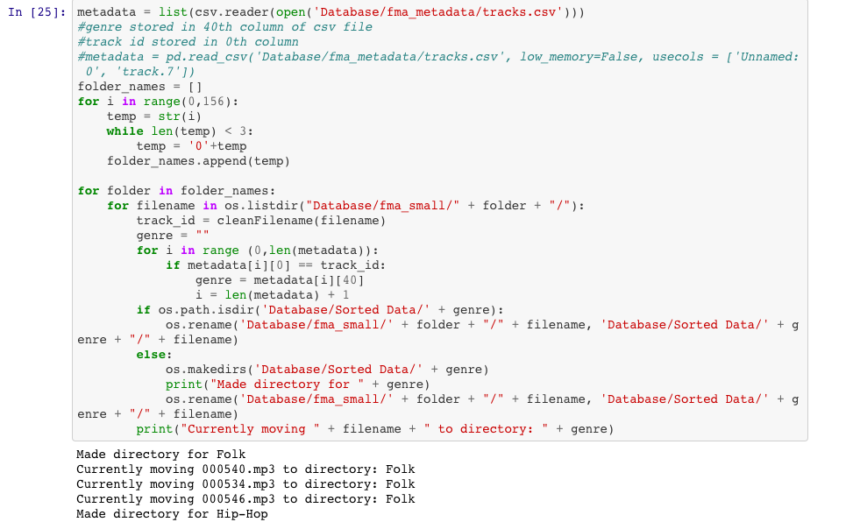
GenreSplit
Loop through the .csv file
Pull out necessary information (filename + genre)
Store the song file into designated folder
If the folder doesn’t exist, create it.

Slide 14
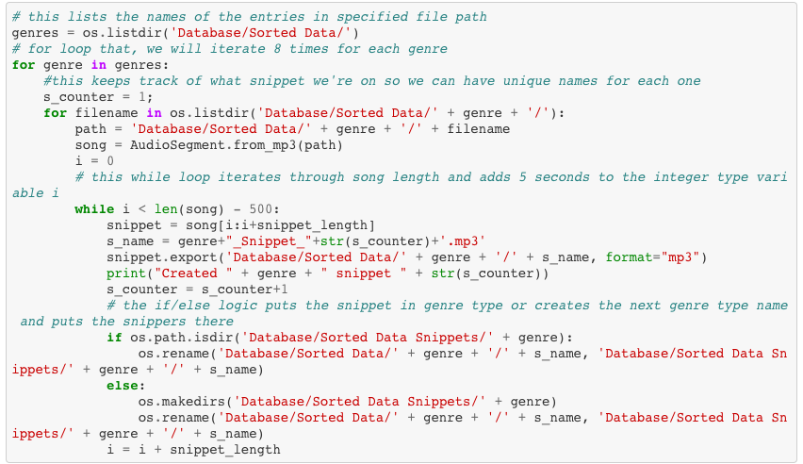
SplitAudio
Loop through the files within the folders
Iterate through the songs to split them up into 5 second intervals
Place these snippets into new folders for their genre

Slide 15
Classification Process
Our program will taken in a song, split it up entirely into five second snippets, and pass the snippets into the neural network.
The network would then make predictions of the snippets’ genres, assigning a value to their prediction. Each value would correspond for a specific genre.
The resulting value with the most instances would be the genre that the song is.

Slide 16
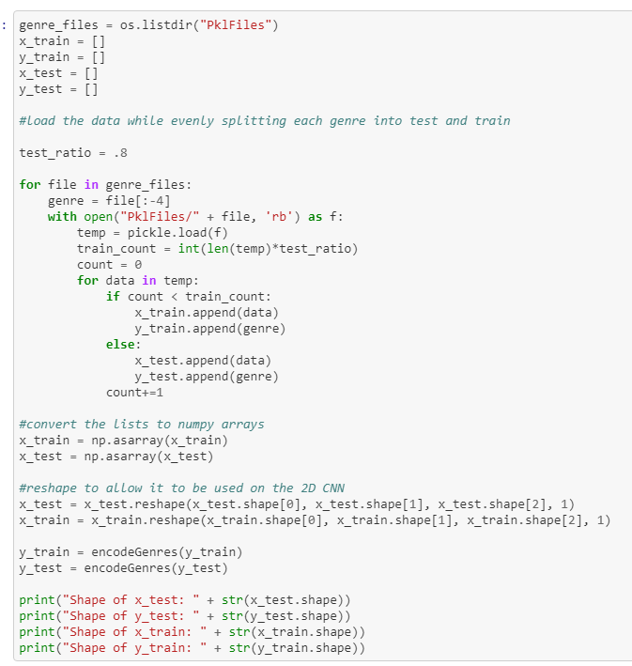
TrainNetwork
Load the pickle files holding our training data
Convert the lists to numpy arrays
Reshape the arrays

Slide 17
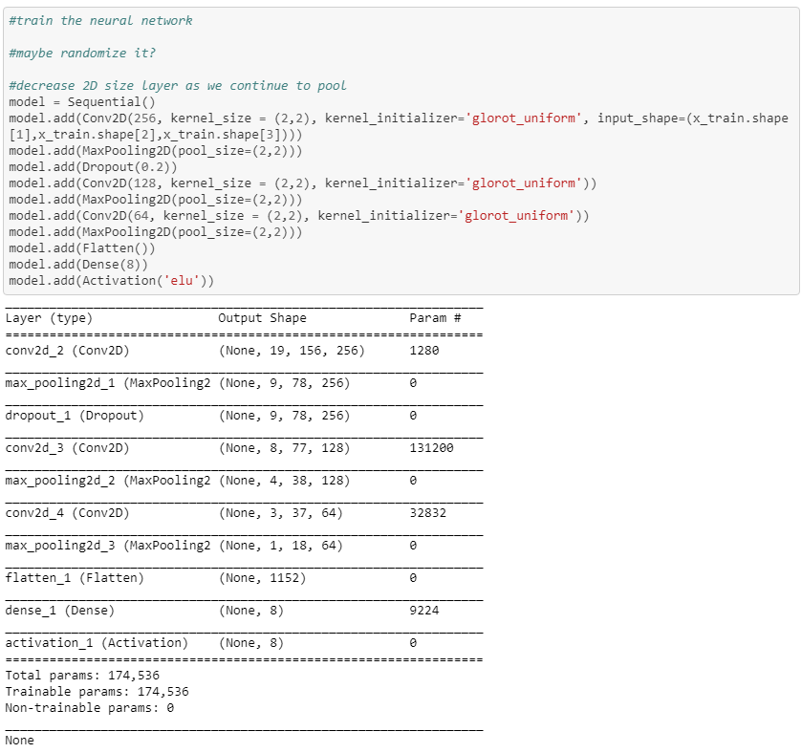
TrainNetwork
Create the layers for our convolutional neural network.

Slide 18
First Results
Through the thanksgiving break, we let the neural network to train.
We managed to get around 60% accuracy on 5 second snippets using MFCC data, so we strived to do better.

Slide 19
Changes
Wanted to remove genres we believed to be redundant, or genres that could be found to sound the same to other genres.
By reducing the number of genres, we could isolate the genres that sound the most different between each other. This would, in theory, result in the neural network distinguishing genres better.
Removed the ‘International’ and ‘Experimental’ genres.

Slide 20
Changes
Both are ways to encode audio, however Spectrograms were able to encode far better than MFCC.
The newly constructed spectrograms use the mel scale to detect differences between the tones of the songs.
Rather than using MFCC encoding, we switched to Mel-scale Spectrograms. This allowed us to encode far more data, as spectrograms hold about 6 times as many values as MFCCs
Mel scale is able to figure out the tonal differences more accurately, as it mimics the way that humans hear sounds

Slide 21
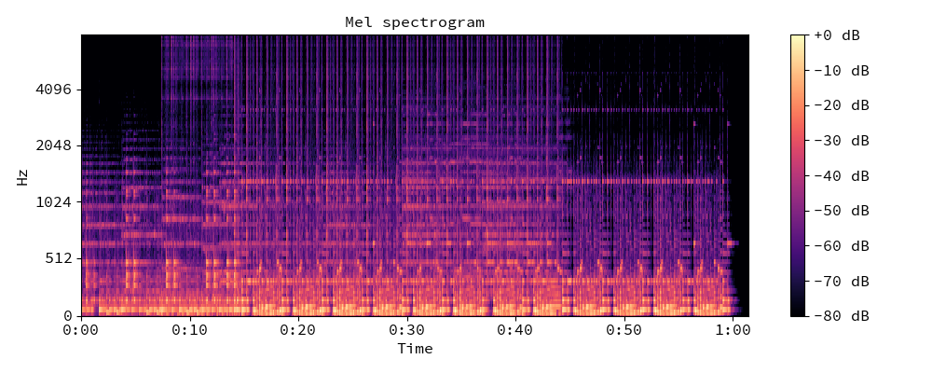
Mel Spectrogram
Source: librosa.github.io [2]

Slide 22
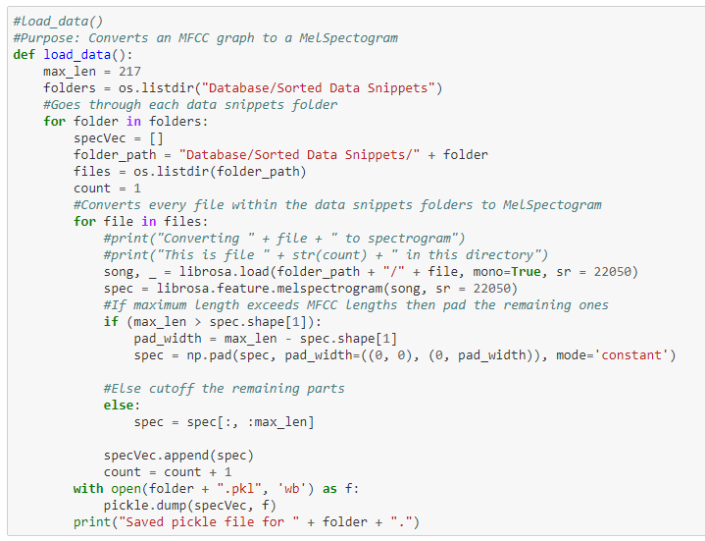
ConvertSpectrogram
Rather than converting the snippets to MFCC, we convert to MelSpectrograms.
Librosa handles the conversion using: librosa.feature.melspectrogram()

Slide 23
Testing Process
Gather up full length songs that would be within the genres trained on.
Break up each song into 5 second snippets.
Load up the snippets as the testing data into the network.

Slide 24
Second Results
Instrumental - The model was 92.308% accurate at classifying Instrumental songs
Hip-Hop - The model was 100.00% accurate at classifying Hip-Hop songs
Electronic - The model was 77.777% accurate at classifying Electronic songs
Pop - The model was 50.0% accurate at classifying Pop songs
Folk- The model was 25.0% accurate at classifying Folk songs
Rock - The model was 42.5% accurate at classifying Rock songs

Slide 25
Second Results
International - No songs to test on
Overall - 70% accurate in general
We believe the neural network would classify rock songs as pop songs, most likely due to the rock songs having slow song parts in them.

Slide 26
More Changes
Remove the pop genre. These genres would cause obstruction when testing as they could sound very similar to other genres depending on the songs the network was being trained on.

Slide 27
Final Results
Instrumental - The model was 87.5% accurate at classifying Instrumental songs
Hip-Hop - The model was 100.0% accurate at classifying Hip-Hop songs
Electronic - The model was 95.0% accurate at classifying Electronic songs
Folk - The model was 85.0% accurate at classifying Folk songs
Rock - The model was 70.0% accurate at classifying Rock songs
It was 0.875% accurate in general

Slide 28
Failures and Successes
Failures:
Close sounding genres caused interference
MFCC did hold as much data that we required.
Few datasets with mp3 files.
Successes:
Network performed well at classifying instrumental, hip-hop and electronic.
Overall accuracy was still high

Slide 29
Moving Forward
Increase the number of genres to incorporate ones that can be deemed harder to interpret.
Train the neural network to identify songs that are more than a single genre.
Identify instruments being played within the song.

Slide 30
Sources
[1] Fayek, H. “Speech Processing for Machine Learning: Filter Banks, Mel-Frequency Cepstral Coefficients (MFCCs) and What’s In-Between”. Online. https://haythamfayek.com/2016/04/21/speech-processing-for-machine-learning.html
[2] Librosa development team. “librosa.feature.melspectrogram”. Online. https://librosa.github.io/librosa/generated/librosa.feature.melspectrogram.html

